Slide 1

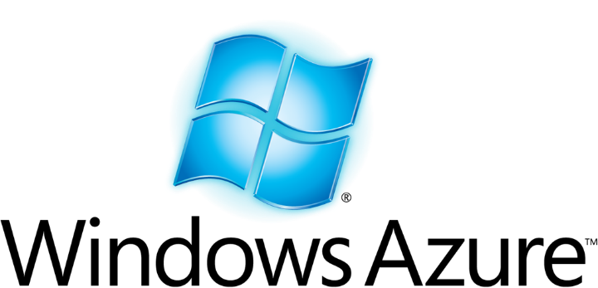

A Tale of Two Clouds
A side by side comparison of
Microsoft Azure and AWS
Andrew Siemer
Clear Measure
andrew@clear-measure.com
@asiemer

Slide 2







Andrew Siemer
http://about.me/andrewsiemer
ASP Insider
MS V-TSP
Father of 6
Jack of all trades, master of some.
Notes:
Andrew Siemer, obstacle races, ranching, shooting, has 6 kids

Slide 3
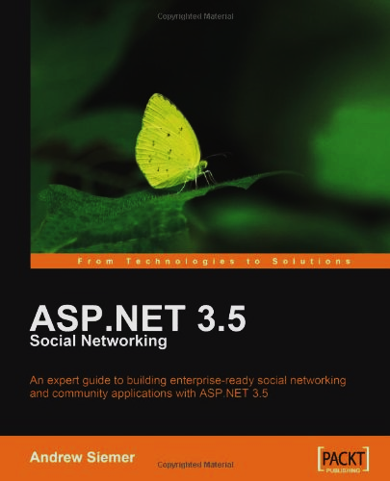
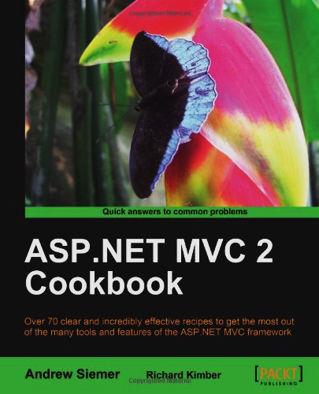
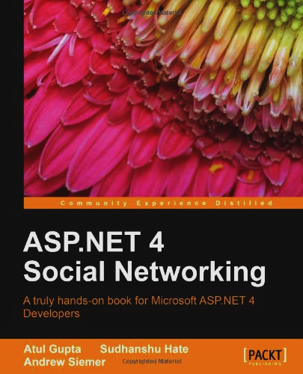

Notes:
Some books I have written or am writing

Slide 4











← We are hiring!!!
Notes:
Some places I have worked and some projects I have worked on

Slide 5
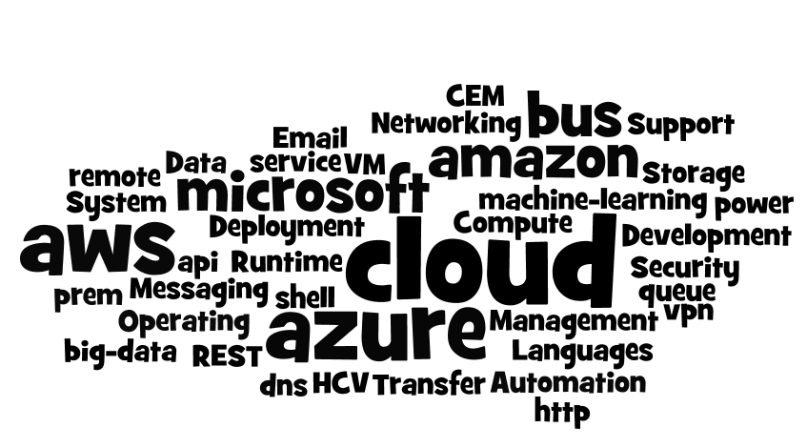
Introduction
Notes:
Today we are going to dig through at a very high level what the Microsoft Azure cloud and Amazon Web Services offer

Slide 6
Introduction
Deployment, Management and Automation
Compute
Storage
Messaging
Email
Networking
Security
Operating System & Data Transfer
Development Languages and Runtime Support
Notes:
More specifically we are going to look at the following concepts

Slide 7
What is a “cloud”?
Notes:
But first…what exactly do we mean when we say cloud?

Slide 8
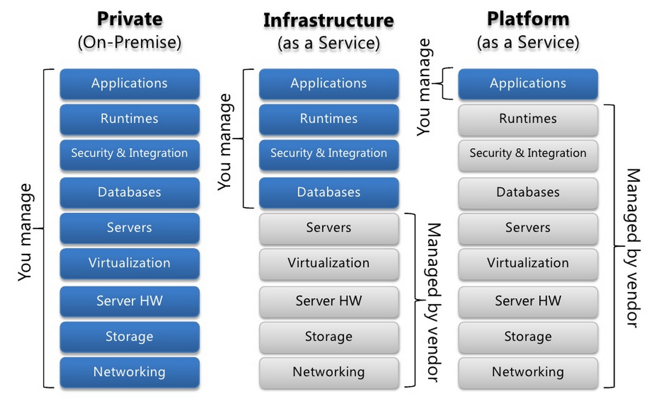
Types of clouds
Notes:
We first need to understand the offerings
Private: you own the app, the run times, and the hardware
IaaS: you own the app and the run times
PaaS: you own the app

Slide 9
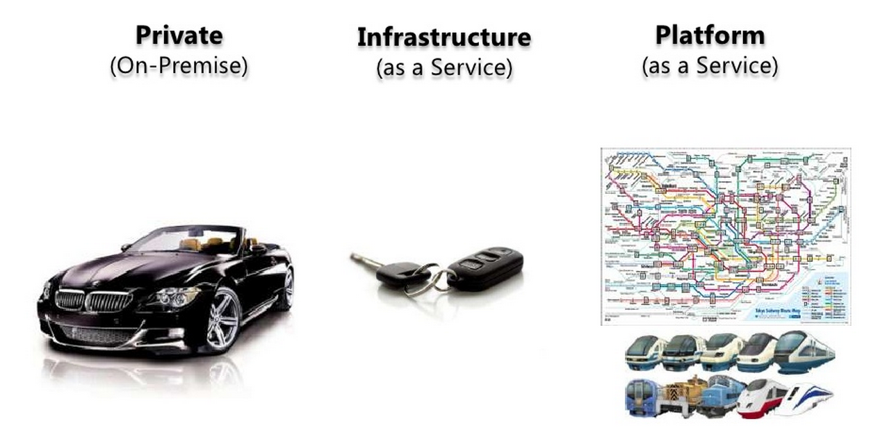
Types of clouds: Private
Notes:
Many company’s have played in the owning of the whole stack. We like to think that it is a shiny Beemer. But let’s face it – running the whole show is hard!

Slide 10
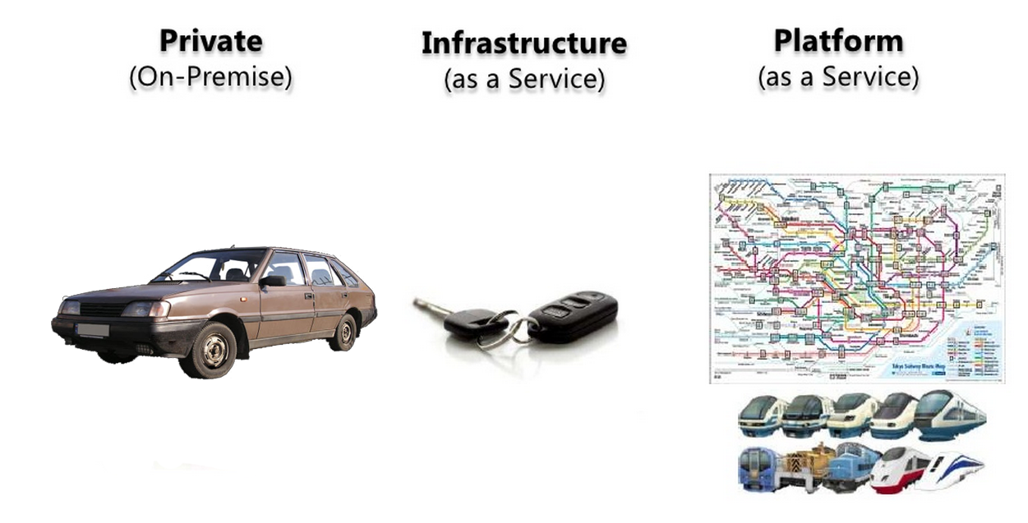
Types of clouds: Private
Notes:
And generally some small to medium companies, and even in some large ones, owning the whole stack doesn’t always turn out overly shiny and can be quite painful to drive.

Slide 11
Types of clouds: Infrastructure
Notes:
This leads many companys to a more virtualized environment. Where the hardware and the software concerns are somewhat separated. If hardware goes down, I can shift an image of a particular service somewhere else. The headaches are less. But you still have to manage the database, security, etc. And as it turns out those things are hard!

Slide 12
Types of clouds: Platform
Notes:
This eventually leads companies towards the cloud where many of the hard things are taken care of for you. But what if you could have the convenience of Platform story in your own data center most of the time? …and the ability to push that to the cloud when you need it?

Slide 13
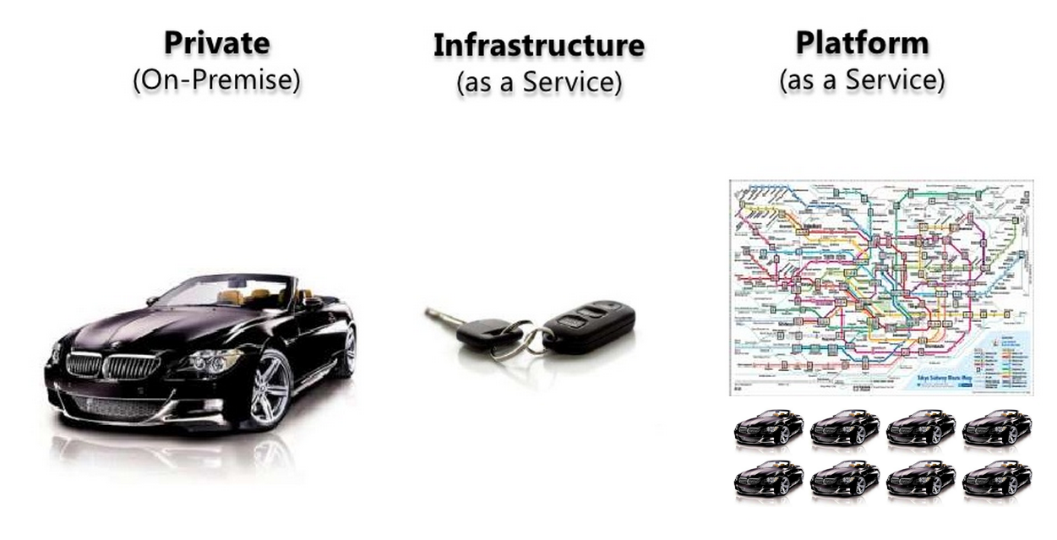
Types of clouds: Platform on prem
With on-prem think AND not OR!

Slide 14
How does Azure and AWS fit?
Infrastructure As A Service (IaaS)
Platform as a Service (Paas)
Two years ago
Amazon Web Services
Microsoft Windows Azure
Now
Amazon Web Services
Microsoft Windows Azure

Slide 15
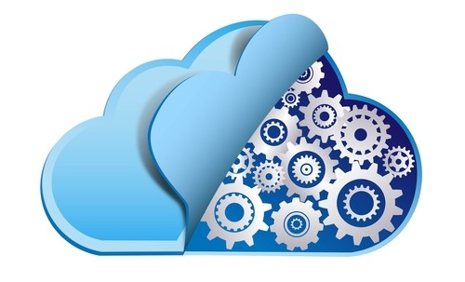
Compute

Slide 16

Deployment, Management, Automation

Slide 17
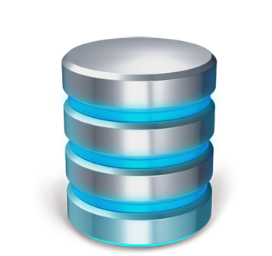
Storage

Slide 18
Storage
AWS
Azure
Kinesis
Elastic Map Reduce
SSD backed VMs
Simple Storage Service
Simple DB
Elastic Block Store
Storage Gateway
CloudSearch
DynamoDB
Glacier
Event Hubs
StreamInsight
SSD backed VMs
Azure Blob Storage
Table Storage
Azure File Storage
VPN
Azure Search
DocumentDB
Site to site
Notes:
Data stream ingestion, data stream processing, SSD, blob storage, table storage, queues, file storage, durable disk, local network , search, nosql

Slide 19
Storage
Telemetry Ingestion
Internet of Things sending large amounts of sensor data
Click tracking metrics
Million of events per second
Notes:
Kinesis and Event Hubs

Slide 20
Storage
Process large amount of data
Ingesting large amounts of data is only awesome if you process it
Reporting
Real time analytics
Notes:
Elastic Map Reduce, streaminsight

Slide 21
Storage
Search all that data
Search driven navigation
Faceted searching
Business driven boosted results
Notes:
Cloud search, elastic search

Slide 22
Storage
Unstructured data
Rapid development
Distributed out of the box
High through put
Notes:
DynamoDB, DocumentDB

Slide 23

Messaging

Slide 24
Messaging
AWS
Azure
Simple Queue Service
Simple Workflow
Simple Notification Service
Kinesis
Azure Queue
Service Bus
Twilio (partner)
Event Hubs

Slide 25

Networking

Slide 26
Cloud Infrastructure
AWS
Azure
IP, Elastic IP, Elastic Load Balancer
Virtual Private Cloud
Route 53 (DNS)
Firewall
Virtual Network
Traffic Manager
Azure Load Balancer
No real DNS management
Firewall

Slide 27
On-prem Infrastructure
AWS
Azure
Direct connect
Azure pack
Site to site connection
Local to cloud connection
Web based provisioning
Scale up/scale out story
Local usage accounting
Linked active directories

Slide 28
Locations
AWS
Azure
N. Virginia
Oregon
N. California
Ireland
Singapore
Tokyo
Sydney
São Palo
GovCloud
N. Central US
S. Central US
W. US
E. US
N. Europe
W. Europe
E. Asia
SE. Asia

Slide 29

Email

Slide 30
Email
AWS
Azure
Simple Email Service
Outbound only
Free: 62k emails
Great if send only
Integrates with other services
SendGrid could be used here too
SendGrid
Free: 25k emails
Inbound
Outbound
Great for marketing efforts
More feature rich
Notes:
SES allows you to send lots of email. It offers simple notifications around failures and the like. But that is pretty much it.
Azure doesn’t really have any built in tooling for sending email. Instead it partnered with SendGrid. Which has a rich set of features for sending, receiving, parsing, analytics, click tracking, etc.

Slide 31
Email
Neither has a good “manage my business email” in the cloud story
You can set up an SMTP/POP3/IMAP in both easily
But wait - Microsoft Office 365
STMP/POP3/IMAP
Awesome integration with Office

Slide 32

Security

Slide 33
Security
AWS
Azure
ISO 27001
PCI DSS
DIACAP Level 2
FISMA
FedRAMP
Government Cloud
ISO 27001
PCI DSS
HIPPA
SSAE 16
Cloud Security Alliance
FedRAMP
CJIS
Azure Government (preview)

Slide 34
Security
ISO 27001
A specification for an information security management system (ISMS). An ISMS is a framework of policies and procedures that includes all legal, physical and technical controls involved in an organization's information risk management processes.

Slide 35
Security
PCI DSS
The Payment Card Industry Data Security Standard is a proprietary information security standard for organizations that handle branded credit cards from the major card brands including Visa, Master Card, American Express, Discover, and JCB. Private label cards, those without a logo from a major card brand are not included in the scope of the PCI DSS.

Slide 36
Security
DIACAP Level 2
The DoD Information Assurance Certification and Accreditation Process is a United States Department of Defense process that means to ensure that companies and organizations apply risk management to information systems. DIACAP defines a DoD-wide formal and standard set of activities, general tasks and a management structure process for the certification and accreditation of a DoD IS that maintains the information assurance posture throughout the system’s life cycle.

Slide 37
Security
FISMA
The Federal Information Security Management Act (FISMA) is United States legislation that defines a comprehensive framework to protect government information, operations and assets against natural or man-made threats.

Slide 38
Security
FedRAMP
The Federal Risk and Authorization management program (FedRAMP) is a government-wide program that provides a standardized approach to security assessment, authorization, and continuous monitoring for cloud products and services.

Slide 39
Security
HIPPA
Health Insurance Portability and Accountability Act sets the standard for protecting sensitive patient data. Any company that deals with protected health information (PHI) must ensure that all the required physical, network, and process security measures are in place and followed.

Slide 40
Security
SSAE 16
Statement on Standards for Attestation Engagements is a regulation created by the Auditing Standards Board (ASB) of the American Institute of Certified Public Accountants (AICPA) for redefining and updating how service companies report on compliance controls.

Slide 41
Security
Cloud Security Alliance
The Cloud Security Alliance (CSA) is a not-for-profit organization with a mission to promote the use of best practices for providing security assurance within Cloud Computing, and to provide education on the uses of Cloud Computing to help secure all other forms of computing. The Cloud Security Alliance is led by a broad coalition of industry practitioners, corporations, associations and other key stakeholders.

Slide 42
Security
CJIS
The Criminal Justice Information Services security policy is to provide appropriate controls to protect the full lifecycle of criminal justice information, whether at rest or in transit.

Slide 43
Security
Government
Physical and network isolation from non-U.S. government deployments
Requires specialized personnel screening

Slide 44
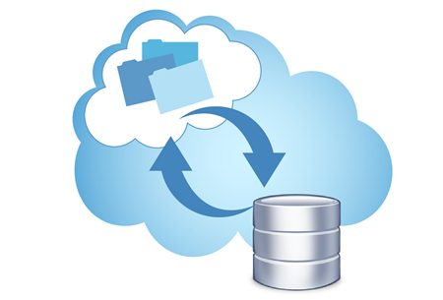
Operating System & Data Transfer

Slide 45
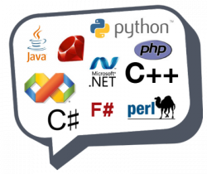
Development Languages & Runtime Support

Slide 46
Development Languages

Slide 47
Languages
AWS
Azure
Java
Python
Ruby
Node.js
Php
PowerShell
.NET
Java
Python
Ruby
Node.js
Php
PowerShell
.NET
Notes:
There are many languages on both platforms.

Slide 48
Languages
AWS
Amazon
Deep visual studio integration
Many SDKs available
Command line tooling
REST APIs
Great documentation
Deep visual studio integration
Many SDKs available
Command line tooling
REST APIs
Pretty good documentation
Notes:
And each of these platforms provide lots of tooling for most of these languages. And where there isn’t direct language support there is a command line tool. And where the command line tools don’t work there is a REST API. This is generally enough.

Slide 49
Runtime Support

Slide 50
Runtime Support
AWS
Amazon
Word Press
Joomla
Droopal
And many many more…
Word Press
Joomla
Droopal
And many many more…

Slide 51
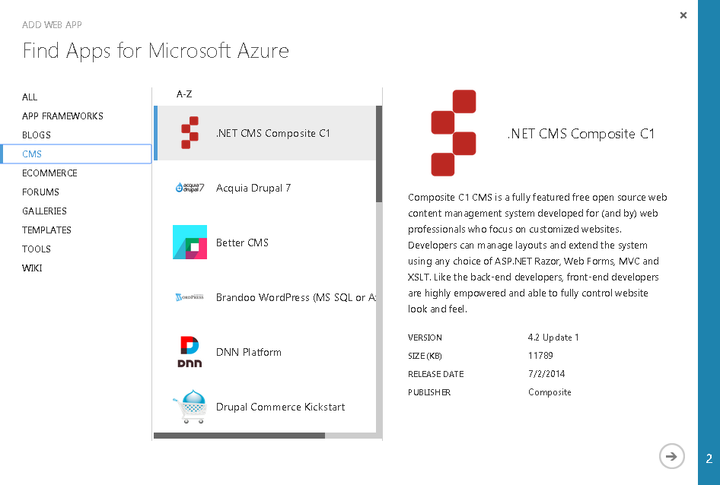
Runtime Support

Slide 52
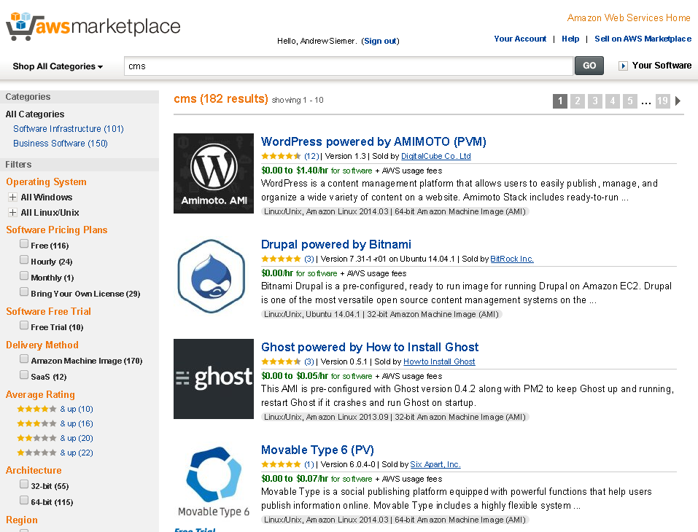
Runtime Support

Slide 53

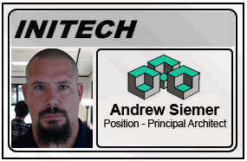
Any questions?
Andrew Siemer
Clear Measure
@asiemer

